Slide 1
Introduction to embedded systems using arduino
Day 1

Slide 2
Agenda
What is Embedded Systems?
What is Microcontroller?
Microcontroller VS microprocessor
Instruction Set Architecture
Computer Architecture
What is Memory & Memory Types?

Slide 3
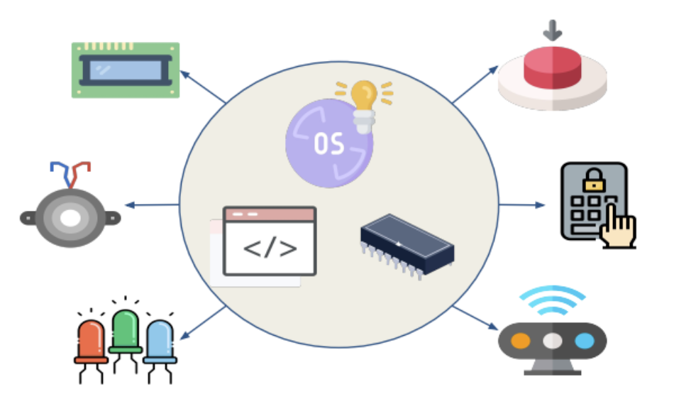
What is embedded systems?
Embedded system is an integrated system that is formed as a combination of computer hardware and software for a specific function.
It is a hardware controlled by a software to perform a specific and periodic functionality
may work independently or attached to a larger system to work on a few specific functions
It may be real-time or not
Notes:
▪Let’s first know the two basic things (Embedded and System), and
what do they mean.
▪ System is a set of interrelated parts/components which are designed/developed to perform common tasks or to do some specific work for which it has been created.
▪Embedded means including something with anything for a reason. Or simply we can say something which is integrated or attached to another thing.

Slide 4
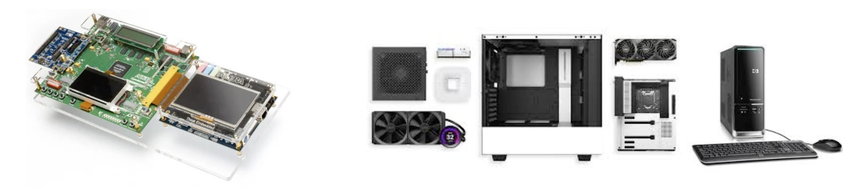
Embedded system Vs PC
Embedded System | Personal Computer
• Mostly designed using a Microcontroller | • Designed using a microprocessor
• Specific Purpose | • General Purpose
• Limited Resources | • Huge Resources
• Requires a smaller number of peripheral devices | • Huge number of peripheral devices

Slide 5
Embedded System Characteristics
Single-functioned: Repeated single functionality
Tightly constrained
Small size
Low power Consumption
Use Microprocessors or Microcontrollers.
Limited Memory
Connected: must be connected to input and output devices.
Reactive and Real time: reacts to change in system environment
Less Human intervention
Highly Stable: Embedded systems do not change frequently
High Efficiency

Slide 6
Advantage & Disadvantage
Advantages
Small size
Lower Power consumption
Lower cost
Enhanced (real-time) performance
Easily Customizable for a specific application
Disadvantages
High development effort & cost
Time-consuming design process
Limited resources, memory, processing power

Slide 7
Embedded System Applications
Automotive: Cruise control, light control, ABS, EBD,ESP, ... etc.
Networking: Routers.
Fintech: ATM, Point Of Sale, Vending machines, ... etc.
Home appliances: Home automation, Air conditioners, microwave ovens, washing machines and dishwashers, . etc.
Biomedical: Wearable devices, Teleradiology, … etc.
Military: Missile targeting systems, command-and-control systems, electronic warfa etc.
Consumer Electronics: MP3 players, television sets, mobile phones, video game consoles, digital cameras, GPS receivers, printers, ... etc.

Slide 8
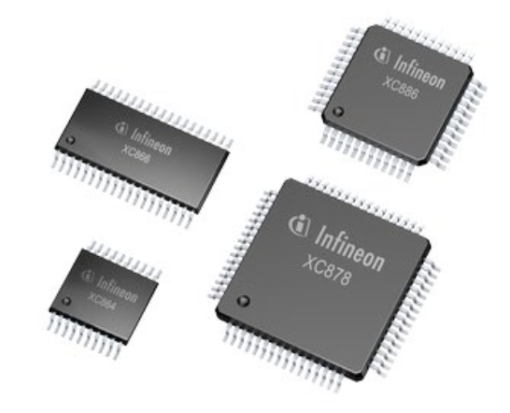
What is Microcontroller
A microcontroller (μC, uC or MCU) is a small computer on a single integrated circuit containing a processor core, memory, and programmable input/output peripherals.
Very common component in modern electronic systems (peripherals)
Examples
PIC
ATMEL
ARM

Slide 9
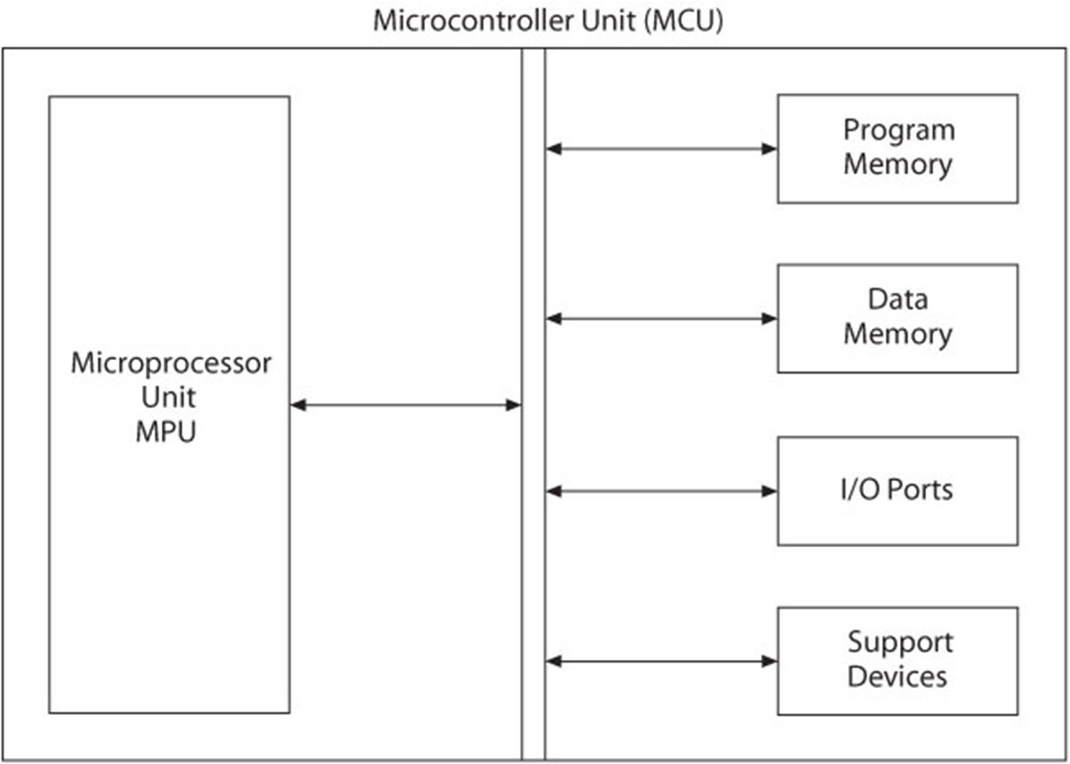
What is Microcontroller

Slide 10
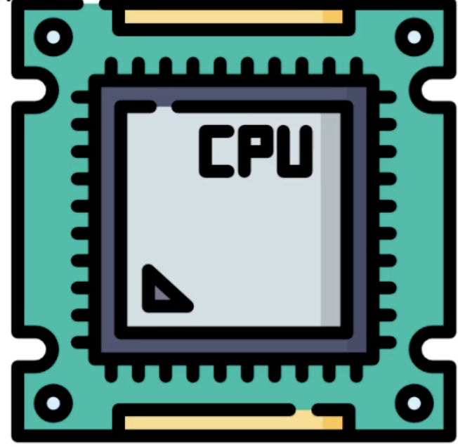
What is a Microprocessor
A microprocessor is an Integrated Circuit unit in a computer system that performs logical, arithmetic and controlling operations.
It is called also Central Processing Unit.
The CPU is the brain of any microcontroller.
It executes all the instructions provided by a program.

Slide 11
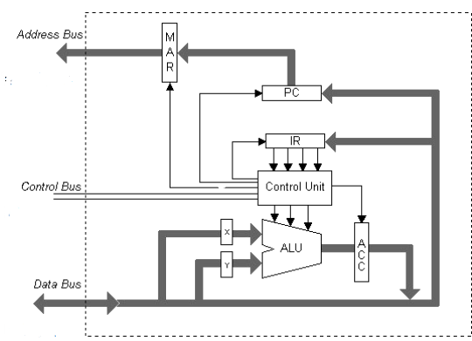
Microprocessor internal components
Arithmetic and logic unit (ALU):
is responsible for all arithmetic and logical operations
Registers:
Are used to facilitate CPU operations
Control Unit:
is responsible for controlling all CPU operations
Data bus:
Data bus: Data carrying wires
Address bus: address carrying wires
Control bus: read/write control signals carrying wires

Slide 12
CPU Registers
Registers are the fastest types of memories.
It is used to facilitate CPU operations.
General Purpose Registers
These are used for internal storage
Special Purpose Registers
Status Register: It contains information about the state of the processor
Program Counter: It contains the memory address of the next instruction to be fetched
Accumulator: This is the most frequently used register used to store data taken from memory
Instruction Register: It holds the instruction which is just about to be executed
Memory Address Register and Memory Data Register: These facilitates memory R/W operations

Slide 13
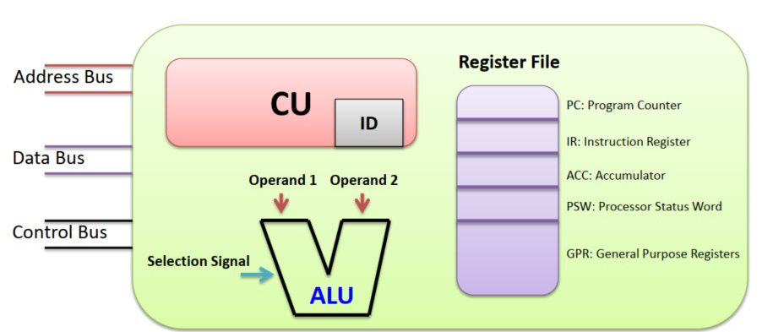
Processor Components

Slide 14
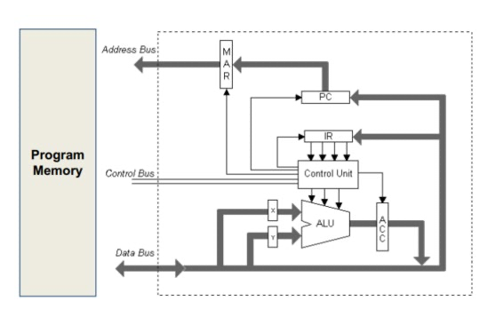
Instruction cycle
Fetch:
PC points to the instruction to be executed
Get instruction Opcode from memory and store it into IR
Decode:
Know what operation will be done
Execute:
The ALU to execute the instruction
Store

Slide 15
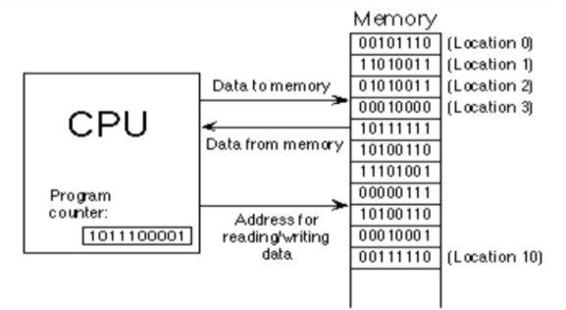
Instruction cycle
Fetch: At the beginning of the fetch cycle, the address of the next instruction to be executed is stored in the Program Counter(PC)

Slide 16
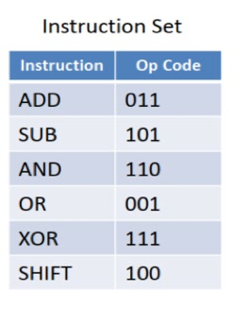
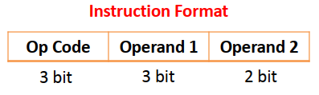
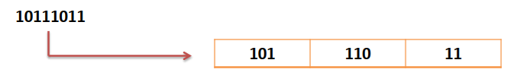
Instruction cycle
Decode: inside CU ”Control Unit” by ID “Instruction Decoder”.
Every processor has its instruction set which is the group of instructions that could be executed by the processor.
Every instruction has a unique binary representation called “Opcode”.
The decoding step is responsible for defining the operation required by the instruction fetched from the memory
then pass these information to the ALU.
Example
101 is the op code for SUB operation.
This means that this instruction is: SUB 6 3

Slide 17
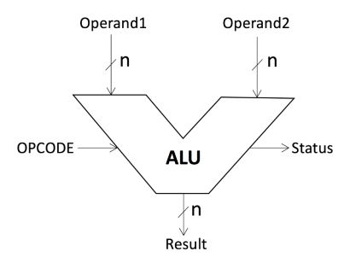
Instruction cycle
Execute : By ALU “Athematic Logic Unit”.
It contains many logic gates for all the supported instructions.

Slide 18
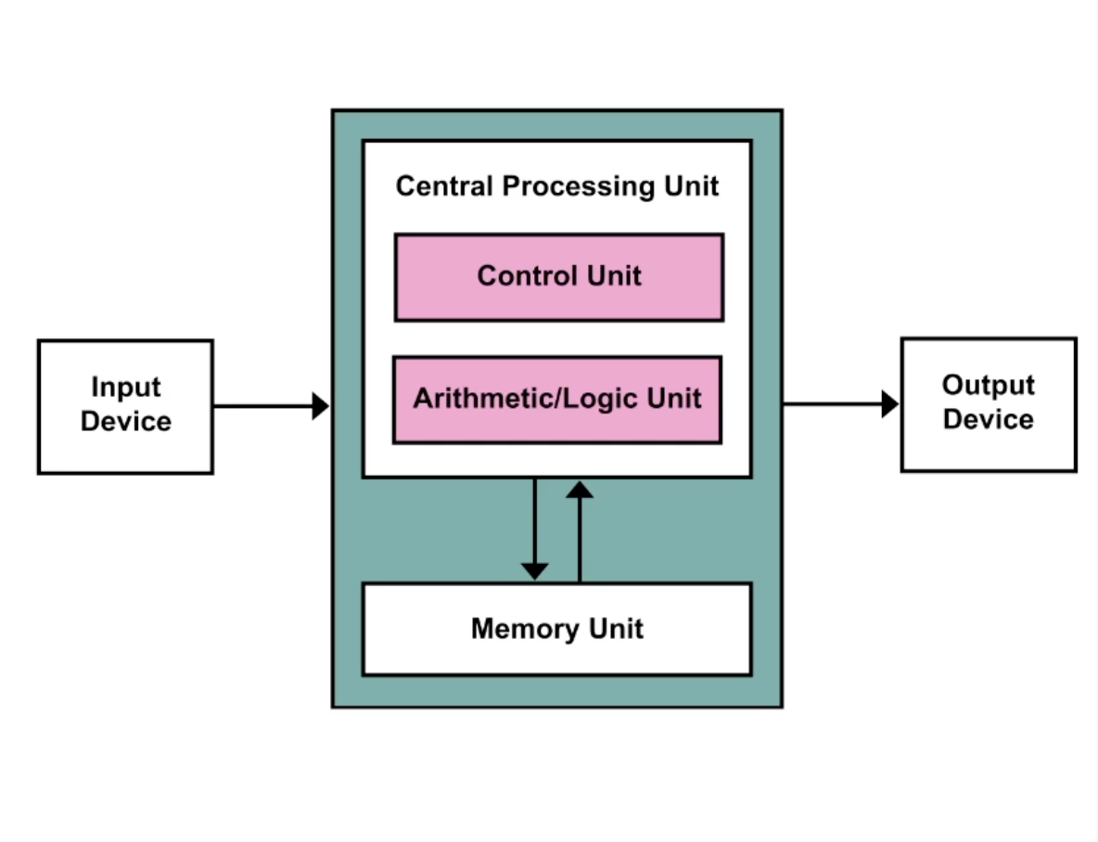
What is computer architecture?
It is a set of rules and methods that describe the functionality, organization, and implementation of computer systems.
It is mainly concerned with CPU, memory, and I/O devices interactions.
Notes:
How computer components interact with eachother

Slide 19
Instruction Set Architecture
It describes the design of a Computer in terms of the basic operations it must support.
It defines the types of instructions to be supported by the processor.
Arithmetic/Logic, Data Transfer, and Branch and Jump Instructions.
It defines the maximum length of each type of instruction.
It defines the Instruction Format of each type of instruction.
It is classified into:
Complex Instruction Set Computing (CISC)
Reduced Instruction Set Computing (RISC)

Slide 20
Reduced Instruction Set Architecture (RISC)
o The main idea behind this is to make hardware simpler by using an instruction set composed of a few basic steps for loading, evaluating, and storing operations just like a load command will load data, a store command will store the data.
o Reduce the cycles per instruction at the cost of the number of instructions per program.
o Reduce the cycles per instruction at the cost of the number of instructions per program.

Slide 21
Reduced Instruction Set Architecture (RISC)
Simpler instruction, (simple instruction decoding)
Instruction comes undersize of one word
Instruction takes a single clock cycle to get executed
More general-purpose registers
Simple Addressing Modes
Fewer Data types
A highly pipeline can be achieved
Optimizes the performance by focusing on software

Slide 22
Complex Instruction Set Architecture (CISC)
The main idea is that a single instruction will do all loading, evaluating, and storing operations just like a multiplication command will do stuff like loading data, evaluating, and storing it, hence it’s complex.
The CISC approach attempts to minimize the number of instructions per program but at the cost of an increase in the number of cycles per instruction

Slide 23
Complex Instruction Set Computer (CISC)
Complex instruction, (complex instruction decoding)
Instructions are larger than one-word size
Instruction may take more than a single clock cycle to get executed
Less number of general-purpose registers as operations get performed in memory itself
Complex Addressing Modes
Less Instruction Pipeline
Optimizes the performance by focusing on hardware

Slide 24
RISC vs. CISC
Reduced Instruction Set Computer (RISC)
Used in: SPARC, ALPHA, Atmel AVR, etc.
Few instructions (usually < 50)
Only a few addressing modes
Executes 1 instruction in 1 internal clock cycle (Tcyc)
Complex Instruction Set Computer (CISC)
Used in: 80x86, 8051, 68HC11, etc.
Many instructions (usually > 100)
Several addressing modes
Usually takes more than 1 internal clock cycle (Tcyc) to execute

Slide 25
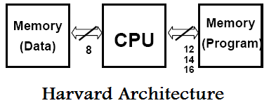
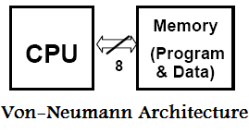
Computer Architecture
The architecture of any micro-controller or a micro-computer mainly refers to the overall arrangement of the constituent CPU
Harvard and Von Neumann architecture serve as the two major ways using which the microcontroller gets its CPU arrangement with the ROM and RAM

Slide 26
Von neumann architecture
Memory holds both programs and data; this is also known as the stored program concept.
Memory is addressed linearly; that is, there is a single sequential numeric address for each and every memory location.
Memory is addressed by the location number without regard to the data contained within.
Memory is split to small cells with the same size. Their ordinal numbers are called address numbers.
Notes:
Von Neumann bottleneck:
Instructions can only be done one at a time and can only be carried out sequentially. Which will make enhancing performance is very hard.
▪Memory holds both programs and data; this is also known as the stored program concept.
▪Memory is addressed linearly; that is, there is a single sequential numeric address for each and every memory location.
▪Memory is addressed by the location number without regard to the data contained within.
▪ Memory is split to small cells with the same size. Their ordinal numbers are called address numbers.
▪Program consists of a sequence of instructions. Instructions are executed in order they are stored in memory
▪Sequence of instructions can be changed only by unconditional or conditional jump instructions
▪Instructions, and data are represented in binary form

Slide 27
Advantages of Von Neumann
Control Unit fetch data and instructions in the same way from one memory
It simplifies design and development of the Control Unit Data from memory and from devices are accessed in the same way
Memory organization is in the hands of programmers

Slide 28
Disadvantages of Von Neumann
Serial instruction processing does not allow parallel execution of program
Parallel executions are simulated later by the Operating system
One bus is a bottleneck. Only one information can be accessed at the same time

Slide 29
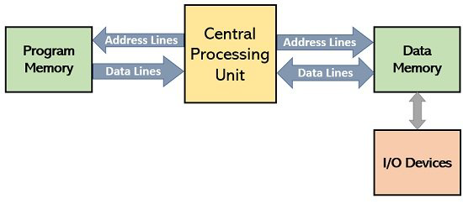
Harvard Architecture
It is the computer architecture that contains separate storage and separate buses for instructions and data.
It is mainly developed to overcome Von-Neumann bottleneck.
The main advantage that the CPU can access instructions and read/write data at the same time.

Slide 30
Advantages of Harvard Architecture
Since it has two memories, this allows parallel access to data and instructions
Data and instructions are accessed the same way Both memories can use different cell sizes

Slide 31
Disadvantages of Harvard Architecture
Free data memory can’t be used for instruction and vice-versa
Production of a computer with two buses is more expensive
Development of the Control Unit is expensive and more complex

Slide 32
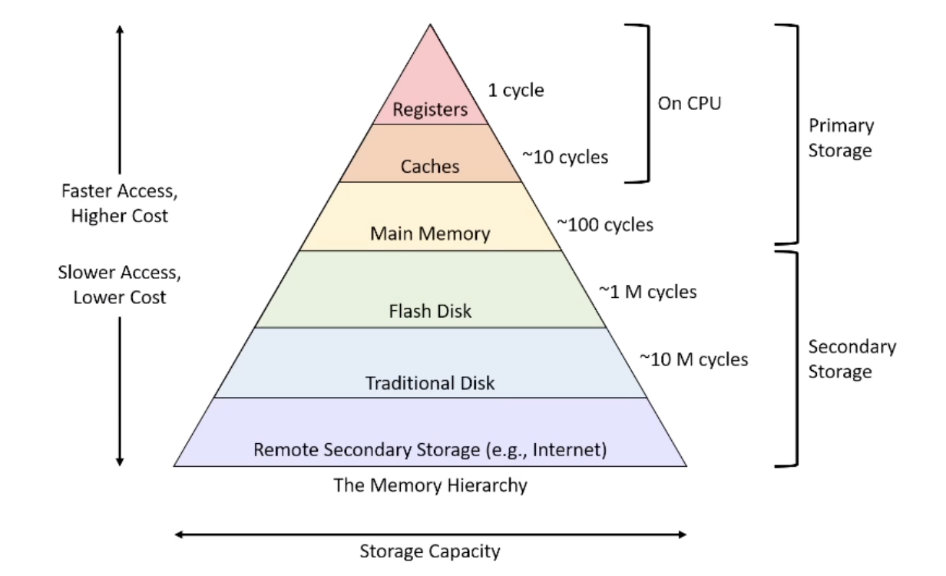
What is Memory?
Memories in computer are electronic components that stores data and program instructions.
Memories are characterized by:
Access speed (read and write)
Capacity
Volatile or non-volatile
Notes:
As the word implies "memory" means the place where we should store any thing, this is very essential part of human being just like this memory is also very important for computer system because in computer system we must store some data or information and for storing these items we need some memory or space.

Slide 33
Volatile vs. Non-volatile Memory
Volatile memory stores data when a computer is on but erases it as soon as the computer is switched off
Whereas Non-volatile memory remains in a computer even after the system shuts off.

Slide 34
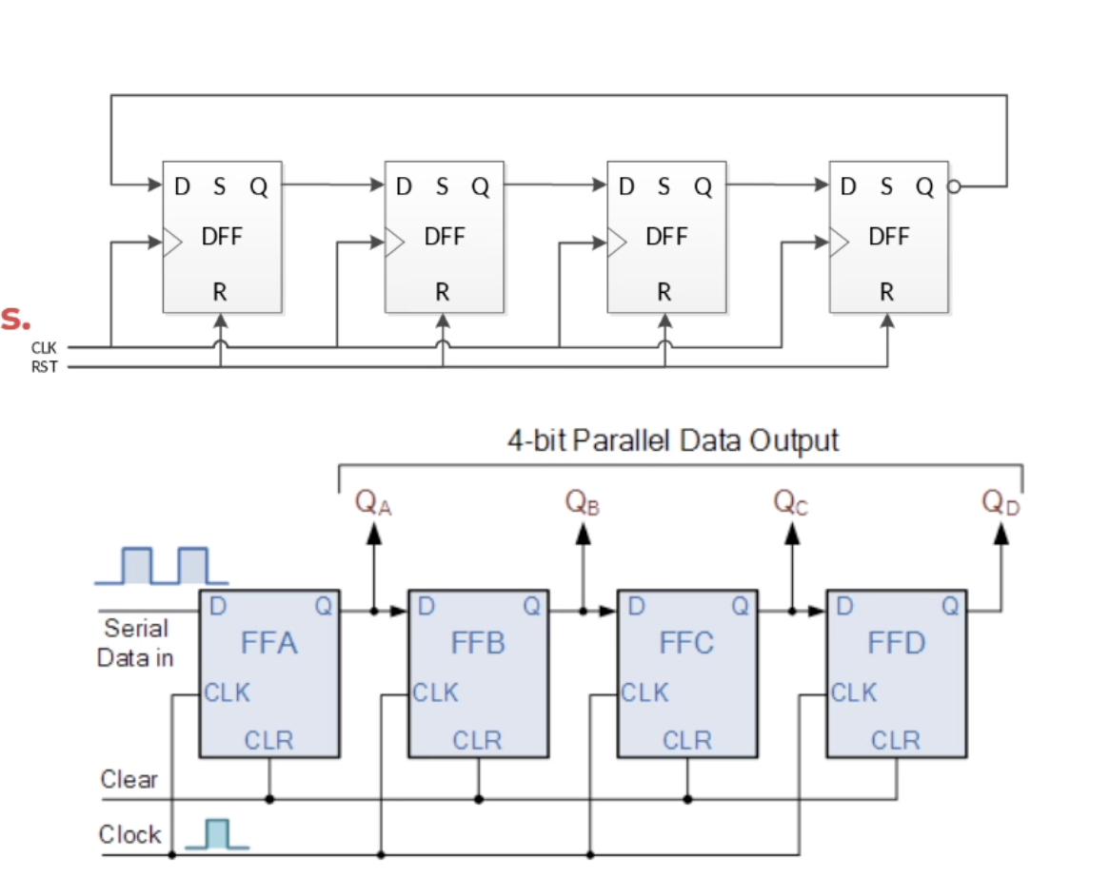
Registers
A register is basically a storage space for units of memory that are used to transfer data for immediate use by the CPU for data processing.
Characteristics: o The fastest memory o Small capacity o Some of them store addresses, instructions, or status
Flip-flops play a vital role in designing the most popular shift registers.
The set of Flip-flops is nothing but a register, used to store numerous data bits.
A Flip-Flop stores only 1-bit
8-bit registers have 8 connected Flip-Flops
Notes:
▪ Types of Shift Register: o Serial in Serial out (SISO) o Serial in parallel out (SIPO) o Parallel in Serial out (PISO) o Parallel in Parallel out (PIPO)

Slide 35
Read Only Memory (ROM)
It is a non-volatile and read only memory
Data stored in these chips is non-volatile
On turn on, the computer loads BIOS from ROM
Data stored in these chips is either unchangeable or requires a special operation to change
Applications: Video Games, Calculators, etc...

Slide 36
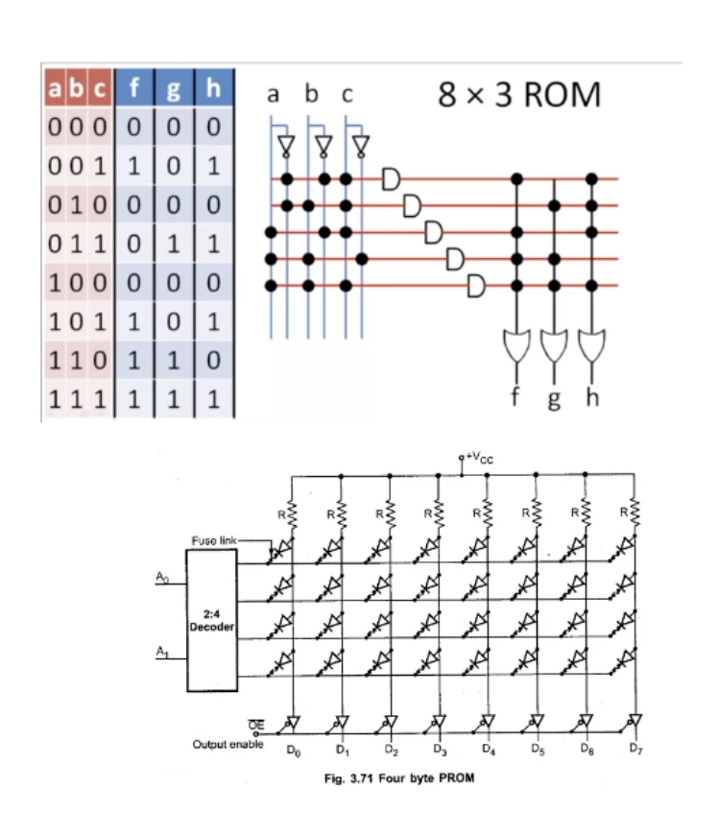
Read Only Memory (ROM)
It is non-volatile and read only memory.
ROM types:
﻿﻿MROM:
﻿﻿ Maskable ROM, and can not be programmed.
﻿﻿PROM:
﻿﻿ Programmable ROM, and can be programmed once.
﻿﻿EPROM:
﻿ Erasable PROM, it can be erased using UV (Ultraviolet ) and reprogrammed.
﻿﻿EEPROM: Electrically EPROM, it can be electrically erased and reprogrammed.
﻿﻿Flash:
﻿ It is EEPROM with larger page size.
Notes:
فيوزات بتتحرق و بعد كلة بتطلع ال Truth table بس بيتعمل مره واحدة

Slide 37
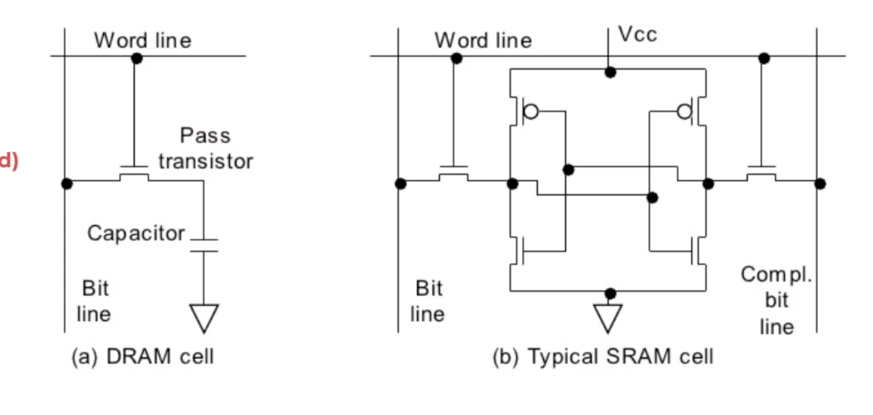
Random Access Memory(RAM)
It is volatile with read/write operations.
Data is stored in transistors and requires a constant power flow
Because of the continuous power, SRAM doesn’t need to be
refreshed to remember the data being stored
SRAM is called static as no change or action i.e.; refreshing is not needed to keep the data intact
It is used in cache memories

Slide 38
Advantages of SRAM
Faster access speed than DRAM Can be used to create a speed-sensitive cache
Medium power consumption

Slide 39
Disadvantages of SRAM
More expensive to manufacture than DRAM
Data can be lost if SRAM is not powered
Low storage capacity
More complex design compared to DRAM
Takes up much more space than DRAM

Slide 40
Random Access Memory(RAM)
Data is stored in capacitors.
Capacitor stores electric charge whose level represents a 1 or 0
Capacitors dissipate with time and hence the charge must be restored frequently
So, a periodic refresh of power is required in order to function every 64 ms
DRAM is called dynamic as constant change or action(change is continuously happening) i.e. refreshing is needed to keep the data intact. It is used to implement main memory.

Slide 41
Advantages of DRAM
More affordable than SRAM (Lower Cost)
Higher storage capacity
Offers a simple structure.
Utilizes logic and circuitry which makes the memory module simpler to setup and use.

Slide 42
Disadvantages of DRAM
DRAM is slower than SRAM Lower access speeds Consumes more power compared to SRAM

Slide 43
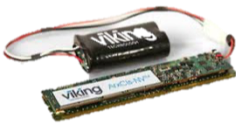
Non-Volatile RAM (NVRAM)
It is a category of RAM that retains stored data even if the power is switched off (just an SRAM with a battery backup)
When the power is turned on, the NVRAM operates just like any other SRAM ▪When the power is turned off, the NVRAM draws just enough power from the
battery to retain its data
NVRAM is common in embedded systems
However, it is expensive--even more expensive than SRAM, because of the battery--so its applications are typically limited to the storage of a few hundred bytes of system-critical information that can't be stored in any better way.
Types: o Battery-backed static RAM o Magneto resistive RAM o Ferroelectric RAM

Slide 44
Advantage of NVRAM
Provides excellent performance when compared to other non-volatile memory products
Supports applications that need quick read or write operations using non-volatile memories, such as antilock braking systems and parallel processing controllers for local area networks.
Less power is required for NVRAMs, so the backup guarantee can be ensured for up to 10 years.

Slide 45
Disadvantage of NVRAM
NVRAM that requires a battery that will eventually need to have the battery replaced.
As information is re-written to flash memory, it deteriorates and will eventually no longer work.

Slide 46
THANks

